Slide 1
AI6140: Health Informatics
Introduction to Health Informatics

Slide 2
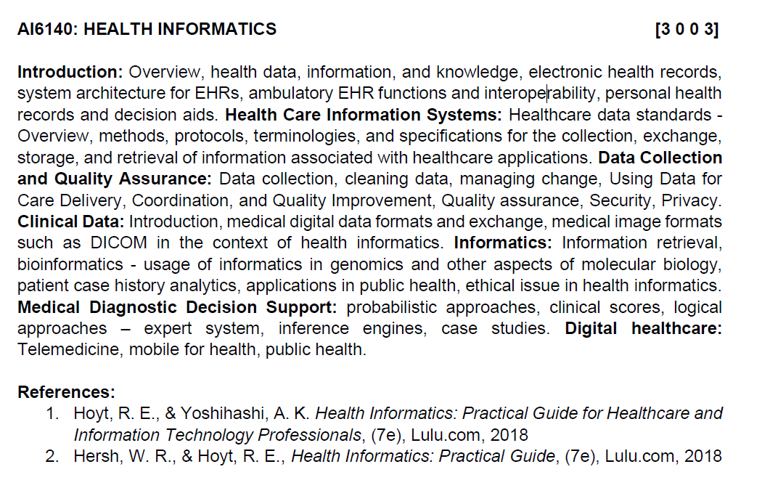
Syllabus

Slide 3
Marks breakdown
MTE – 30 marks
CWS – 30 marks
[ 3 quizzes (15 marks) |
2 assignment (15 marks)]
ETE – 40 marks

Slide 4
Data vs. Information
Data:
  Unprocessed information
  i.e. customer, course, employee
  Building blocks of information
Information:
  Produced by processing data which is related
  i.e. credit card statement, phone bill, video rental
Accurate and timely information is need for decision making
Good decision making is key to an organization’s survival

Slide 5
Some views
Early definition: “storage, acquisition, and use of information” (Greenes, 1990)
Other (US) perspectives
  “The science of information applied to biomedicine … data plus meaning.” (Bernstam, 2010)
  Paradigm shift in biomedicine from “individual brains to systems of brains” (Stead, 2010)
  AMIA: “The interdisciplinary field that studies and pursues the effective uses of biomedical data, information, and knowledge for scientific inquiry, problem solving, decision making, motivated by efforts to improve human health” (Kulikowski, 2012)
European and global perspectives (Haux, 2010; Hasman, 2011; Geissbuhler, 2011)

Slide 6
defining “informatics”
Informatics is an emerging discipline that has been
defined as the study, invention, and implementation
of data structures and algorithms to improve
communication, interpretation, understanding and
management of information in order to help solve
application-specific problems
In our case, the application is healthcare

Slide 7
What informatics “is and isn’t” (Friedman, 2013)
Is
  Cross-training where basic informational sciences meet a biomedical application domain
  Relentless pursuit of assisting people
  Tower of achievement
    Model formulation
    System development
    System implementation
    Study of effects
Isn’t
  Scientists or clinicians tinkering with computers
  Analysis of large data sets per se
  Circumscribed roles related to deployment of electronic health records (*point of disagreement)
  Profession of health information management
  Anything done using a computer

Slide 8
Modern Healthcare
Continuing surge in knowledge about medicine
– New ways to diagnose, treat and cure disease
Continuing ignorance
– Mental illness, stroke management, arthritis
– Malaria & other tropical diseases
– Detect early/cure heart disease and cancer
Ageing population
– Life expectancy (in the West) is increasing
– The body is already outliving the brain
Social, political, economic challenges
– Irrespective of political leaning, healthcare costs are dominating
western economies
– Expectation vs reality
– developed and undeveloped worlds

Slide 9
It also has an “adjective problem”
Imaging Informatics
Research Informatics
{Clinical field} Informatics
Consumer Health
Informatics
Bioinformatics
(cellular and molecular)
Medical or Clinical
Informatics
(person)
Public Health
Informatics
(population)
Biomedical and Health Informatics
Legal Informatics
Chemoinformatics
Informatics = People + Information + Technology

Slide 10
related terms
Information and communications technology (ICT) – same as IT with added emphasis on telecommunications
eHealth – use of ICT for health
Telemedicine – provision of healthcare when participants separated by time and/or distance
Telehealth – pursuit of health when separated by time and/or distance
mHealth – use of mobile devices for health
Digital health – broad term for IT-related aspects of health and healthcare

Slide 11
Other related terms
Evidence-based medicine (EBM) – the application of the best scientific evidence in medical decision-making
Evidence-based practice (EBP) – the application of EBM in clinical practice
Comparative effectiveness research (CER) – research that compares one or more diagnostic or treatment options to evaluate effectiveness, safety or outcomes (also called patient-centered outcomes research)
Information retrieval (also known as search, part of larger knowledge management) – the field devoted to searching (mostly text, mostly knowledge-based information)

Slide 12
Terms related to medical/clinical records
Electronic health record (EHR) – patient’s health record in digital form
  Has mostly supplanted electronic medical record (EMR)
Personal health record (PHR) – personally controlled health record
Health information exchange (HIE) – exchange of health information across traditional business and other boundaries (a verb)
  Organization managing HIE used to be called a Regional Health Information Organization (RHIO), now called an HIE (a noun)

Slide 13
A final perspective of informatics
Data ➔ Information ➔ Knowledge
  Used in many fields but introduced in informatics by Blum (1984)
Data are the raw material collected and stored
Information gives meaning and organization to the data
Knowledge provides understanding and applicability to new situations
Some add wisdom, as knowing how to apply knowledge (Rowley, 2007)

Slide 14
Health information and technology job descriptions (HIMSS, 2020)
Analytics/Report Writer
Application Analyst
Applied Data Scientist
Business Analyst
Chief Business Development Officer
Chief Digital Officer
Chief Experience Officer (Cxo) (Chief Patient Experience Officer)
Clinical Information Specialist
Chief Medical Officer
Chief Medical Information Officer
Chief Nursing Informatics Officer
Chief Privacy Officer
Chief Risk Officer
Chief Technology Officer
Clinical Systems Analyst
Clinical Transformation Analyst
Compliance Professional
Cyber Architect
Data Analyst
Data Analyst – Health Plan
Data Architect
Database Administrator
Data Manager
Data Privacy Analyst
Data Security Analyst
Desktop/Field Services Technician
Director Of Clinical Information Systems
Document Integrity Specialist
Information Security Manager
Integration Analyst
IT Auditor and Risk Analyst
Nurse Informaticist
Privacy Specialist
Process Engineer/Process Improvement Specialist
Program/Project Manager
Quality Analyst
Revenue Cycle Analyst
Risk Professional
Sales, Solutions Specialist
Security Analyst
Senior Privacy Specialist
Senior Solutions Architect
Service Desk Analyst
Senior System Administrator
Senior Director of Business Intelligence
Software Developer
Systems Architect
Telemedicine/Telehealth Nurse Practitioner
Vice President, Chief Information Officer
Vice President, IT Operations
https://www.himss.org/resources/health-information-and-technology-job-descriptions

Slide 15
More information (cont.), Journals
Journals of AMIA
  JAMIA – https://academic.oup.com/jamia
  JAMIA Open – https://academic.oup.com/jamiaopen
Methods of Information in Medicine (MIM)
International Journal of Medical Informatics (IJMI)
Journal of Medical Internet Research (JMIR)
  JMIR Medical Informatics
Journal of Biomedical Informatics (JBI)
Applied Clinical Informatics (ACI)
  ACI Open
Bioinformatics
Journal of Digital Imaging (JDI)
Biomed Central (BMC, https://www.biomedcentral.com/)
  BMC Medical Informatics and Decision Making
  BMC Bioinformatics

